Slide 2
Chapter 1: Introduction
Part A: Core Concepts
Part B: The Practicalities
Rationale, Scope and Background of Cultural Risk Assessment and CIERA
Chapter 2:
Chapter 8:
Cultural Risk Assessment & The Cultural Inclusivity and Equity Risk Assessment (CIERA)
Chapter 3: Cultural Risk – EEDI and Bias
Activating Theory -
England and Wales Cricket Board
Chapter 9:
Chapter 4: The Science of Inclusion and Bias
Managing Organisational Risk: Integrating Cultural Risk Awareness into Corporate Governance
Chapter 10:
Chapter 5: Culture
Chapter 11:
Comparing faith in cultural contexts: In Sacred Spaces and on the Dancefloor
Chapter 6: Theories and Frameworks
Chapter 12:
Activating Theory - Action Research with Faith Leaders for the British Ritual Innovation in COVID
Chapter 7: Cultural Intelligence (CQ)
Chapter 13:
Between the lines -
Conversations in Context, a Dialogical Approach
Part C: Case Studies
CS 1: Sweden – Religious Heritage
CS 10: UK – Faith and Sexuality
CS 2: UK – Sensory Rooms
CS 6: Qatar – Football World Cup
CS 11: UK – Cultural Events
CS 3: England – Prom Events
CS 7: USA – NFL
CS 12: USA – Belonging and Ethnicity
CS 4: UAE – Cultural Awareness
CS 8: Japan – Cultural Heritage
CS 13: Caribbean – Diaspora Communities
CS 5: Australia – Indigenous Communities
CS 9: UK – Sport and Gender
CS 14: Nigeria – Business Events

Slide 3
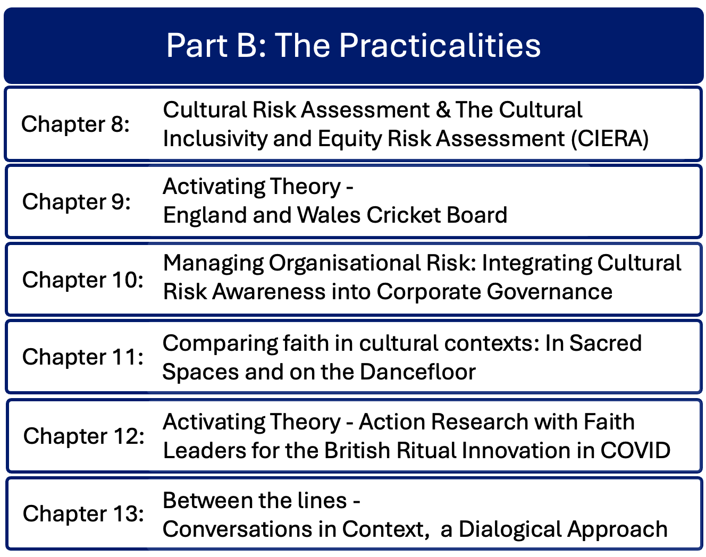

Slide 4
Chapter 10: Managing organisational risk – Integrating cultural risk awareness into corporate governance.
Rachel Lomax & Dan Lomax
Conversation with the ex-Deputy Chair of the British Council and ex-Deputy Governor of the Bank of England
Considers better management of organisational risk by integrating awareness of cultural risk into the domain of corporate governance
Considers the role and composition of boards of directors and wider corporate leadership in setting organisational purpose and mission.
Outlines audit, risk and regulatory responsibilities, and summarises issues of cultural risk from a corporate governance perspective.

Slide 5
Introduction
Strategic level thinking is vital for organisations considering cultural risks in all aspects of event management, to mitigate or avoid institutional risk
Initial review of values and policies influences the appropriateness of event content and client organisations
The organisation’s Board and Directors need to articulate stakeholder values and how these are reflected in the vision and mission

Slide 6
Corporate Governance
Consists of the systems, principles and processes governing how organisations are directed and controlled
Role of the Board of Directors – oversight and evaluation of executive officers and senior managers
Leadership in setting company purpose, values and strategy
Board composition – diversity encourages constructive debate with awareness of cultural issues

Slide 7
Audit and risk issues
Broad areas of corporate risk: strategic, operational, financial, compliance and regulatory, reputational, environmental and social, cybersecurity and technology
Different perspectives on cultural norms influence issues of cultural risk in corporate governance
Need a clear understanding of the organisation’s regulatory responsibilities relevant to the sector and geographic location.

Slide 8
International perspectives
Operating across and / or selling in international locations requires an understanding of diverse cultures as well as regulations
Challenge of balancing diverse culture and values and understanding why and where differences exist
Diverse representation at board level and local expertise enables greater understanding of cultural differences

Slide 9
Creating clear vision and mission statements
Aims to create a tool to communicate to internal and external stakeholders and audiences
Frames employee motivation and expectations
Sets out organisational values
Addresses strategic level concerns – values, policies, resources and processes

Slide 10
Summary – contribution to the cultural risk assessment
Organisations need to consider strategic processes and approaches to EEDI and other cultural issues
Board responsibility is to define the organisation’s mission and vision
Board composition should reflect diversity, including culture
An organisation’s mission statement can be used to assess and address cultural risks

Slide 11
Discussion Questions (Chapter 10)
What is the value of developing a comprehensive mission statement when responding to issues arising relating to cultural risks?
How can organizations develop an understanding of the different international perspectives of what constitutes cultural risk if they are operating in multiple territories?
How can board composition help organizations manage cultural risks?
Identify an events organization that you have some knowledge of: what would be your first three actions to introduce elements within the organization to address cultural risks at a strategic level?

Slide 12
Chapter 11: Comparing faith in cultural contexts – in sacred spaces and on the dancefloor.
Gavin Mart, Ruth Dowson & Dan Lomax
Compares aspects of faith in two different cultural contexts: in sacred spaces and on the dancefloor.
Identifies theological foundations and cultural immersion explored by churches, connecting cultural risk to the process of eventization of faith.
Identifies elements of faith-based events activity that benefit from incorporating analysis of cultural risk into strategic planning.
Discusses safeguarding and limitations of leadership when engaging in cultural activities, offering a new model of cultural engagement.
Compares secular events from the music industry and the dance floor, summarising the complications that arise from faith organisations adopting cultural practices of the secular world.

Slide 13
Introduction
There are impacts for churches engaging in events activity
Churches need to consider the theological aspects of eventization of faith
Comparisons with the secular dance floor
Both church and secular events encompass homogenization of meaning, search for authenticity and belonging

Slide 14
Faith in the cultural context
Engaging in contemporary culture offers benefits and challenges to churches
Such events may (or may not) attract secular / on-religious people into liberal forms of religious experience
Risks commodification, moral compromise and demands on leadership
UK examples: nightclub churches, alternative worship spaces, churches as event venues, adopting café culture
Issues with outsourcing event operations and hire, a drain on internal resources

Slide 15
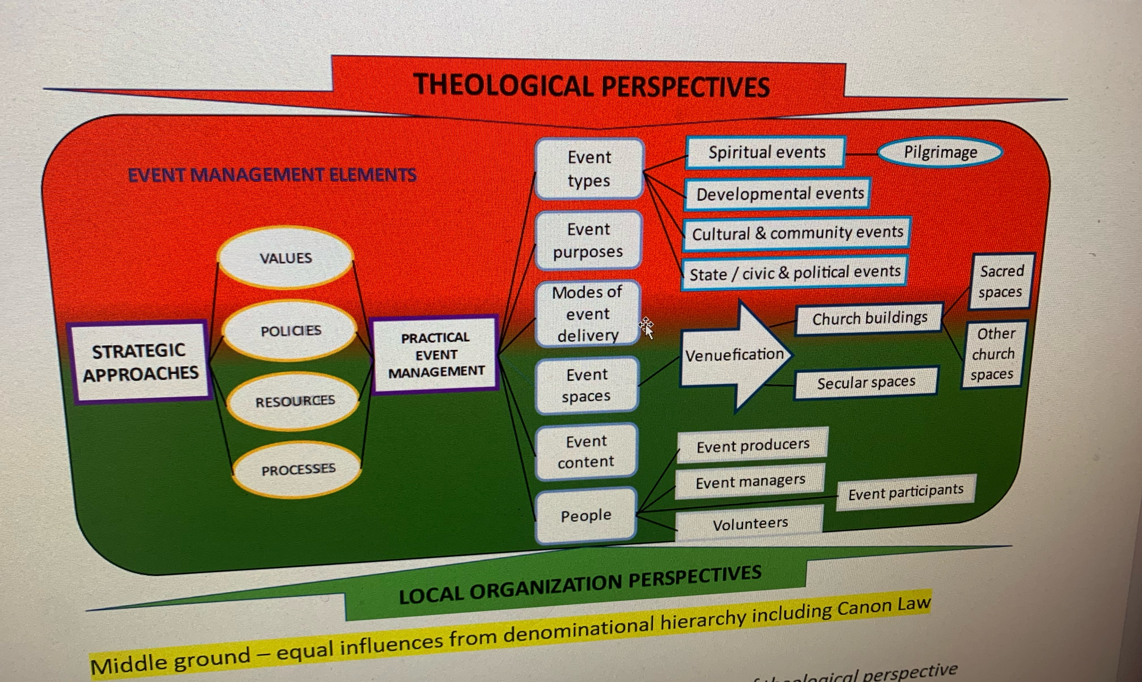
Eventization of faith
Dowson, 2026
Events in churches navigate sacred and secular
Cultural disconnects between church and secular society include understanding of what is appropriate in church
Equally, churches need more professional and strategic approaches to events delivery and awareness of cultural competence

Slide 16
Theological foundations and cultural immersion
Christian theology has considered the relationship between faith and culture for over 75 years eg Niebuhr (1951) form opposition to transformation
More recently Emerging Church acknowledges culture’s intrinsic role in faith expression
Should churches mirror secular culture to remain accessible?
Economic push for churches to engage in events and contemporary culture
Need to balance cultural relevance with theology and events expertise

Slide 17
Cultural Risk and Eventization of Faith
Contemporary cultural events are characterised by immersive experiences
Risks – commodification and conflict with theological positioning
Risk – offer of an event programme with no faith connection
Risk – pressure of event-driven churches on leadership workload

Slide 18
Emerging church practices – lessons and limitations
30 years of initiatives resulted in leadership and resourcing challenges
Need for robust accountability structures and safeguarding processes
Balance innovation and critical reflection
Introduce event-specific safeguarding policies and procedures

Slide 19
The role of aesthetics and space
Creative expression at the heart of cultural engagement
Architectural inspiration and opportunities for theological dialogue
Alternative Christian communities embraced the arts to create bridges between sacred and secular, fostering social transformation

Slide 20
Deconstruction and the necessity of endings
Deconstruction of formulaic liturgy and worship can result in creative re-imagining
Awareness of over-deconstruction that removes all boundaries
Need for willingness to embrace endings, using the Eventization of faith model and the Cultural Risk Assessment to guide the process
Closure and decommissioning of church buildings seen as failure
New spaces needed for new expressions of church
Emphasis on flexibility, inclusion and openness to change

Slide 21
Safeguarding and leadership in eventized faith
Blending sacred and secular requires more diligent safeguarding throughout the event planning and delivery process
Role of the Cultural Risk Assessment throughout the safeguarding process
Training in event management and safeguarding needed for all leaders, staff teams and volunteers
Requires practical theological reflection to create sustainable and inclusive spaces

Slide 22
Integrating the Arts, theology and community engagement
Art offers powerful opportunities for dialogue and community connection
Churches are filled with art and meaning
Art used for theological transfer especially in eras of low literacy
Superdiverse communities should explore diverse cultural forms to address cultural complexity
Cultural competence aids appreciation of difference

Slide 23
Towards a generative model of cultural engagement
The Eventization of faith model offers a strategic and operational framework to enable churches to navigate cultural engagement
Cultural Risk Assessment offers an approach to identify cultural complexities
Artistic inclusion, creative communities and critical reflection help develop welcoming spaces
Prioritising safeguarding and addressing cultural risks supports operational event spaces grounded in theology, fostering mutual dialogue

Slide 24
A secular perspective
Features of religious worship have been incorporated into secular cultural practices, without transfer of meaning
Aim of many secular music events is transcendence
DJs leading music events eg raves seen as parallel with priest leading religious worship, and dancers become the congregation
Secular events seek to create belonging and authenticity

Slide 25
What are the complications?
Churches appropriating secular cultural contexts risk adopting wider influences
Eventization of Faith framework requires an overlay of theological consideration, identifying what is appropriate in a church space
The Cultural Risk Assessment facilitates this process
Churches gain cultural relevance in superdiverse contexts with deep theological consideration of event practices
Safeguarding and training of clergy / ordinands should include eventization of faith and Cultural Risk Assessment

Slide 26
Discussion questions
What are the similarities between secular dance events and church events and their cultures?
How would they benefit from undertaking a cultural risk assessment?
How aware do host venues need to be of the content and style of the events that are taking place in their spaces?
What additional factors do churches need to be aware of when hiring out their spaces to external organisations for events?
What training needs arise for churches as a result of safeguarding issues?

